Slide 1
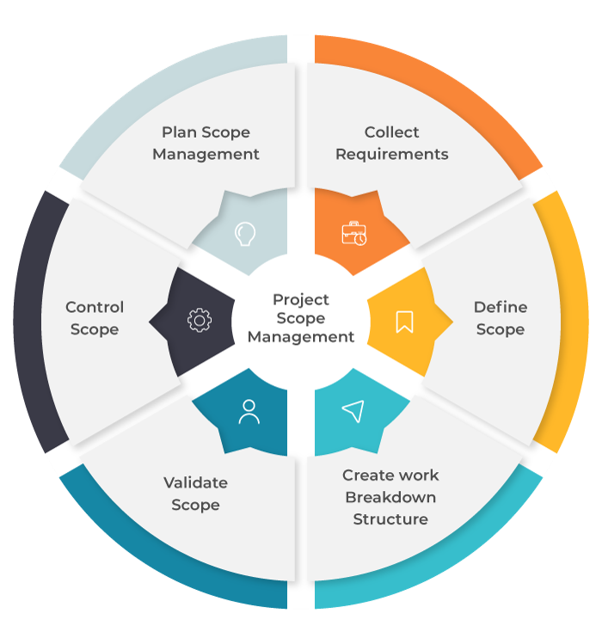
Project Scope Management

Slide 2

What is Project Scope?
Work that needs to be accomplished to deliver a product, service, or result with the specified features and functions.

Slide 3

What is Project Scope?
Detailed set of deliverables or elements of a project, which are derived from a project’s requirements.

Slide 4
What is Project Scope Management?
Project scope management includes the processes involved in defining and controlling what work is or is not included in a project.
Planning
the
Scope
Collecting
Requirements
Defining
the
Scope
Creating
a WBS
Validating
the
Scope
Controlling
the
Scope

Slide 5
Planning scope management
Determines how the project’s scope and requirements will be managed
The project team works with appropriate stakeholders to create a scope management plan & requirements management plan

Slide 6
Planning scope management
How to prepare a detailed project scope statement:
Templates or guidelines to follow
How much detail is needed to describe each deliverable

Slide 7
Planning scope management
How to create a WBS:
This section provides suggestions, samples, and resources for creating a WBS

Slide 8
Planning scope management
How to obtain and approve the WBS:
The initial WBS often changes, and the project team members often disagree on what should be included
The scope management plan describes guidelines for maintaining the WBS and getting approval for it

Slide 9
Planning scope management
How to obtain formal acceptance of the completed project deliverables:
It is important to understand the process for obtaining formal acceptance of completed deliverables, especially for projects in which payments are based on formal acceptance

Slide 10
Planning scope management
How to control requests for changes to the project scope:
Organizations often have guidelines for submitting, evaluating, and approving changes to the scope, and this section specifies how to handle change requests for the project
Notes:
How to plan, track, and report requirements activities
How to perform configuration management activities
How to prioritize requirements
How to use product metrics
How to trace and capture attributes of requirements

Slide 11
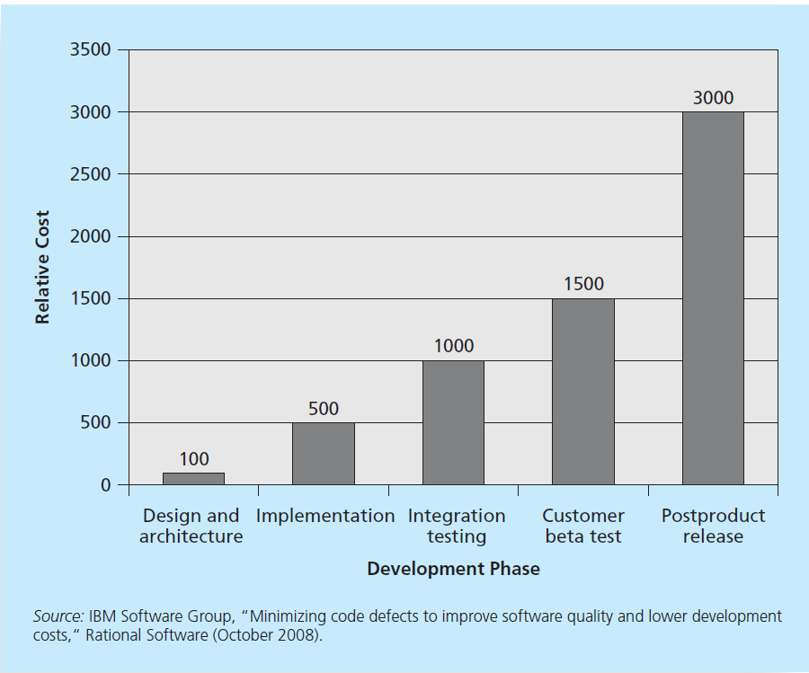
Collecting requirements
A major consequence of not defining requirements well is rework, which can consume up to half of project costs
Notes:
For example, if you are designing a house, it is much cheaper
to decide where windows and walls will be on paper or a computer screen than after the
entire house is framed

Slide 12

Collecting requirements
Interviewing stakeholders one on one (it can be expensive and time-consuming)
Notes:
How to plan, track, and report requirements activities
How to perform configuration management activities
How to prioritize requirements
How to use product metrics
How to trace and capture attributes of requirements

Slide 13

Collecting requirements
Holding focus groups and facilitated workshops, and using group creativity and decision-making techniques (normally faster and less expensive than one-on-one interviews)
Notes:
How to plan, track, and report requirements activities
How to perform configuration management activities
How to prioritize requirements
How to use product metrics
How to trace and capture attributes of requirements

Slide 14

Collecting requirements
Questionnaires and surveys can be efficient ways to collect requirements as long as key stakeholders provide honest and thorough information.
Notes:
How to plan, track, and report requirements activities
How to perform configuration management activities
How to prioritize requirements
How to use product metrics
How to trace and capture attributes of requirements

Slide 15

Collecting requirements
Observation can also be a good technique for collecting requirements, especially for projects that involve improving work processes and procedures
Notes:
How to plan, track, and report requirements activities
How to perform configuration management activities
How to prioritize requirements
How to use product metrics
How to trace and capture attributes of requirements

Slide 16
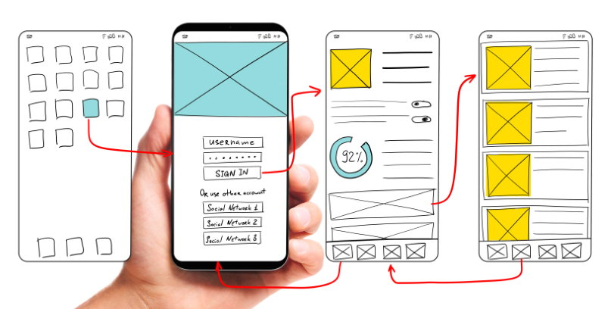

Collecting requirements
For software development projects, prototyping and document
analysis are common techniques for collecting requirements
Notes:
How to plan, track, and report requirements activities
How to perform configuration management activities
How to prioritize requirements
How to use product metrics
How to trace and capture attributes of requirements

Slide 17
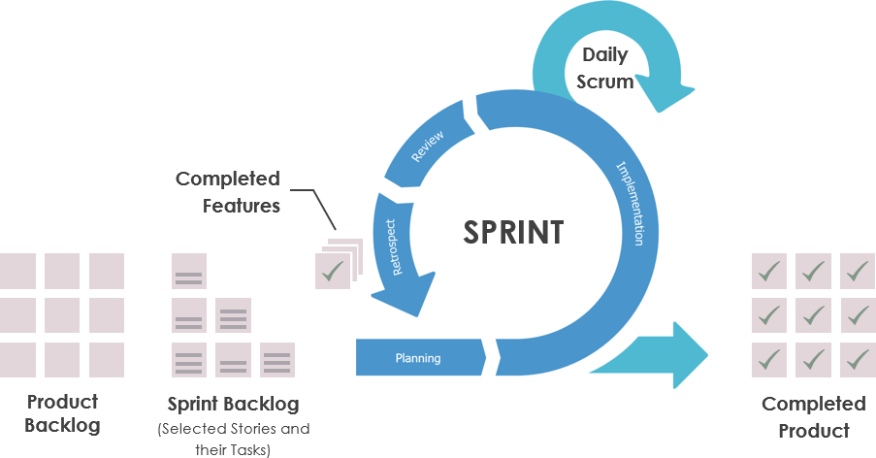
Collecting requirements
On agile software development
projects, the product owner creates the prioritized product backlog for each sprint
Notes:
How to plan, track, and report requirements activities
How to perform configuration management activities
How to prioritize requirements
How to use product metrics
How to trace and capture attributes of requirements

Slide 18
Some statistics
88% of the software projects involved enhancing existing products instead of creating new ones
Notes:
How to plan, track, and report requirements activities
How to perform configuration management activities
How to prioritize requirements
How to use product metrics
How to trace and capture attributes of requirements

Slide 19
Some statistics
86% of respondents said that customer satisfaction was the most important metric for measuring the success of development projects
Notes:
How to plan, track, and report requirements activities
How to perform configuration management activities
How to prioritize requirements
How to use product metrics
How to trace and capture attributes of requirements

Slide 20
Some statistics
82% said that feedback from customers and partners was
the main source of product ideas and requirements
Notes:
How to plan, track, and report requirements activities
How to perform configuration management activities
How to prioritize requirements
How to use product metrics
How to trace and capture attributes of requirements

Slide 21
Some statistics
73% said the most important challenge for their teams was gaining a clear understanding of what customers wanted
Notes:
How to plan, track, and report requirements activities
How to perform configuration management activities
How to prioritize requirements
How to use product metrics
How to trace and capture attributes of requirements

Slide 22
Some statistics
75% of respondents were managing projects with at least 100 requirements
20% were managing projects with over 1,000 requirements
Notes:
How to plan, track, and report requirements activities
How to perform configuration management activities
How to prioritize requirements
How to use product metrics
How to trace and capture attributes of requirements

Slide 23
Some statistics
70% of respondents spent at least 10% of their time managing
changes to requirements
30% spent more than 25% of their time on such changes
Notes:
How to plan, track, and report requirements activities
How to perform configuration management activities
How to prioritize requirements
How to use product metrics
How to trace and capture attributes of requirements

Slide 24
Some statistics
The majority of software development teams used a hybrid methodology
26% used waterfall or modified waterfall techniques, and 19% used agile techniques
Notes:
How to plan, track, and report requirements activities
How to perform configuration management activities
How to prioritize requirements
How to use product metrics
How to trace and capture attributes of requirements

Slide 25
Some statistics
83% of software development teams still use Microsoft Office applications such as Word and Excel as their main tools to communicate requirements
Notes:
How to plan, track, and report requirements activities
How to perform configuration management activities
How to prioritize requirements
How to use product metrics
How to trace and capture attributes of requirements

Slide 26
Some statistics
The respondents listed “requirements collaboration and management software” and “requirements modeling and visualization” as the top two software tools on their wish list
Notes:
How to plan, track, and report requirements activities
How to perform configuration management activities
How to prioritize requirements
How to use product metrics
How to trace and capture attributes of requirements

Slide 27
Defining scope
Good scope definition is very important to project success because it helps improve the accuracy of time, cost, and resource estimates
As time progresses, the scope of a project should become more clear and specific.
Notes:
How to plan, track, and report requirements activities
How to perform configuration management activities
How to prioritize requirements
How to use product metrics
How to trace and capture attributes of requirements

Slide 28
Defining scope
An up-to-date project scope statement is an important document for developing and confirming a common understanding of the project scope.
Notes:
How to plan, track, and report requirements activities
How to perform configuration management activities
How to prioritize requirements
How to use product metrics
How to trace and capture attributes of requirements

Slide 29
Creating the WBS
After collecting requirements and defining scope, the next step in project scope management is to create a work breakdown structure.
Notes:
How to plan, track, and report requirements activities
How to perform configuration management activities
How to prioritize requirements
How to use product metrics
How to trace and capture attributes of requirements

Slide 30
Creating the WBS
A work breakdown structure (WBS) is a deliverable-oriented grouping of the work involved in a project that defines its total scope.
Notes:
How to plan, track, and report requirements activities
How to perform configuration management activities
How to prioritize requirements
How to use product metrics
How to trace and capture attributes of requirements

Slide 31
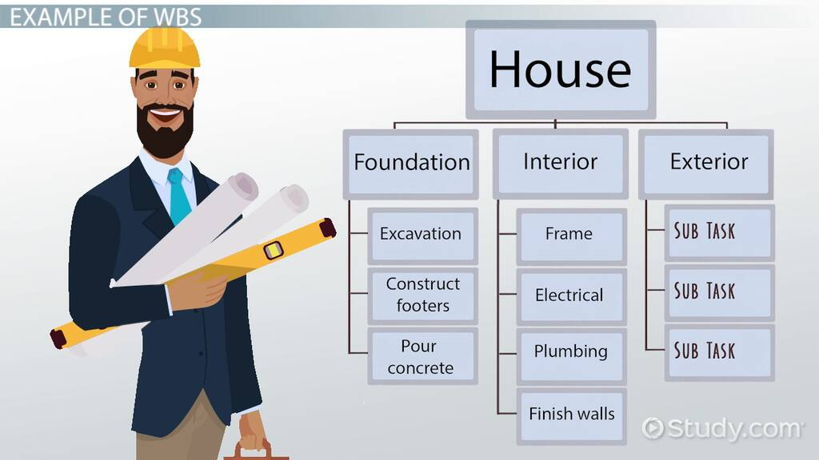

Slide 32
Creating the WBS
Because projects involve many people and many different deliverables, it is important to organize and divide the work into logical parts based on how the work will be performed.
Notes:
How to plan, track, and report requirements activities
How to perform configuration management activities
How to prioritize requirements
How to use product metrics
How to trace and capture attributes of requirements

Slide 33
Creating the WBS
The WBS is a foundation document in project management because it provides the basis for planning and managing project schedules, costs, resources, and changes.
Notes:
How to plan, track, and report requirements activities
How to perform configuration management activities
How to prioritize requirements
How to use product metrics
How to trace and capture attributes of requirements

Slide 34
Creating the WBS
Because the WBS defines the total scope of the project, some project management experts believe that work should not be done on a project if it is not included in the WBS.
Notes:
How to plan, track, and report requirements activities
How to perform configuration management activities
How to prioritize requirements
How to use product metrics
How to trace and capture attributes of requirements

Slide 35
Creating the WBS
The project scope management plan, scope statement, requirements documentation, enterprise environmental factors, and organizational process assets are the primary inputs for creating a WBS.
Notes:
How to plan, track, and report requirements activities
How to perform configuration management activities
How to prioritize requirements
How to use product metrics
How to trace and capture attributes of requirements

Slide 36
Creating the WBS
The main tool or technique is decomposition—that is, subdividing project deliverables into smaller pieces.
Notes:
How to plan, track, and report requirements activities
How to perform configuration management activities
How to prioritize requirements
How to use product metrics
How to trace and capture attributes of requirements

Slide 37
Creating the WBS
A WBS is often depicted as a task-oriented tree of activities,
similar to an organizational chart.
Notes:
How to plan, track, and report requirements activities
How to perform configuration management activities
How to prioritize requirements
How to use product metrics
How to trace and capture attributes of requirements

Slide 38
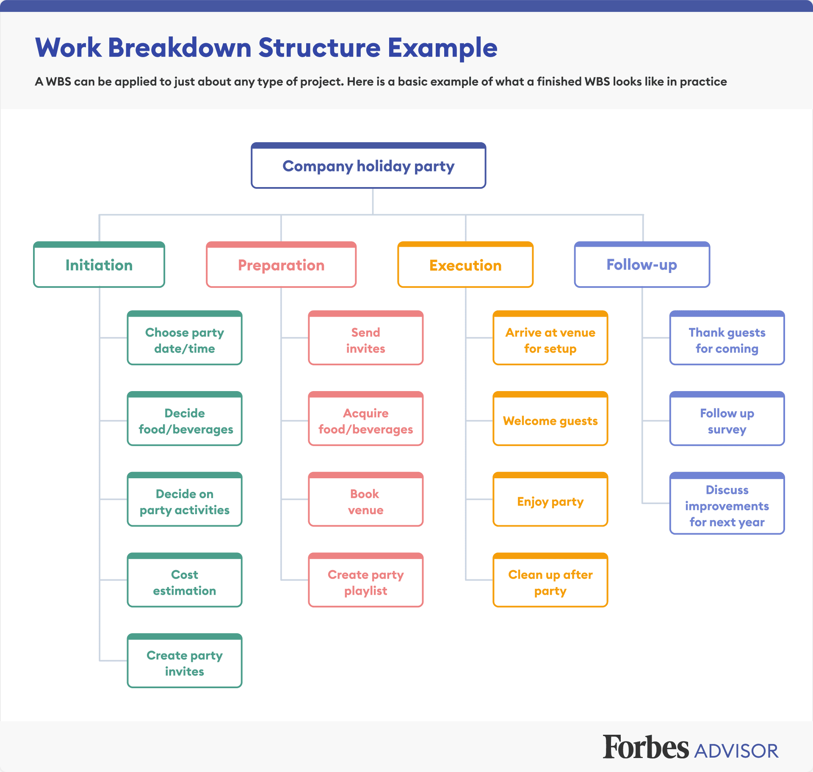
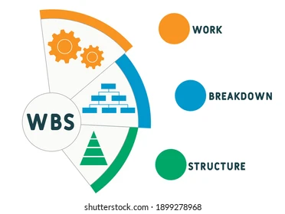

Slide 39
Creating the WBS
A work package is a task at the lowest level of the WBS
A work package also represents the level of work that the project manager monitors and controls
Notes:
How to plan, track, and report requirements activities
How to perform configuration management activities
How to prioritize requirements
How to use product metrics
How to trace and capture attributes of requirements

Slide 40
Creating the WBS
If a project has a relatively short time frame and requires weekly progress reports, a work package might represent work completed in one week or less.
Notes:
How to plan, track, and report requirements activities
How to perform configuration management activities
How to prioritize requirements
How to use product metrics
How to trace and capture attributes of requirements

Slide 41
Creating the WBS
If a project has a very long time frame and requires quarterly progress reports, a work package might represent work completed in one month or more.
Notes:
How to plan, track, and report requirements activities
How to perform configuration management activities
How to prioritize requirements
How to use product metrics
How to trace and capture attributes of requirements

Slide 42
Creating the WBS
A work package should be defined at the proper level so the project manager can clearly establish an estimate of the effort needed to complete it, estimate the cost of all required resources, and evaluate the quality of the results when the work package is finished.
Notes:
How to plan, track, and report requirements activities
How to perform configuration management activities
How to prioritize requirements
How to use product metrics
How to trace and capture attributes of requirements

Slide 43
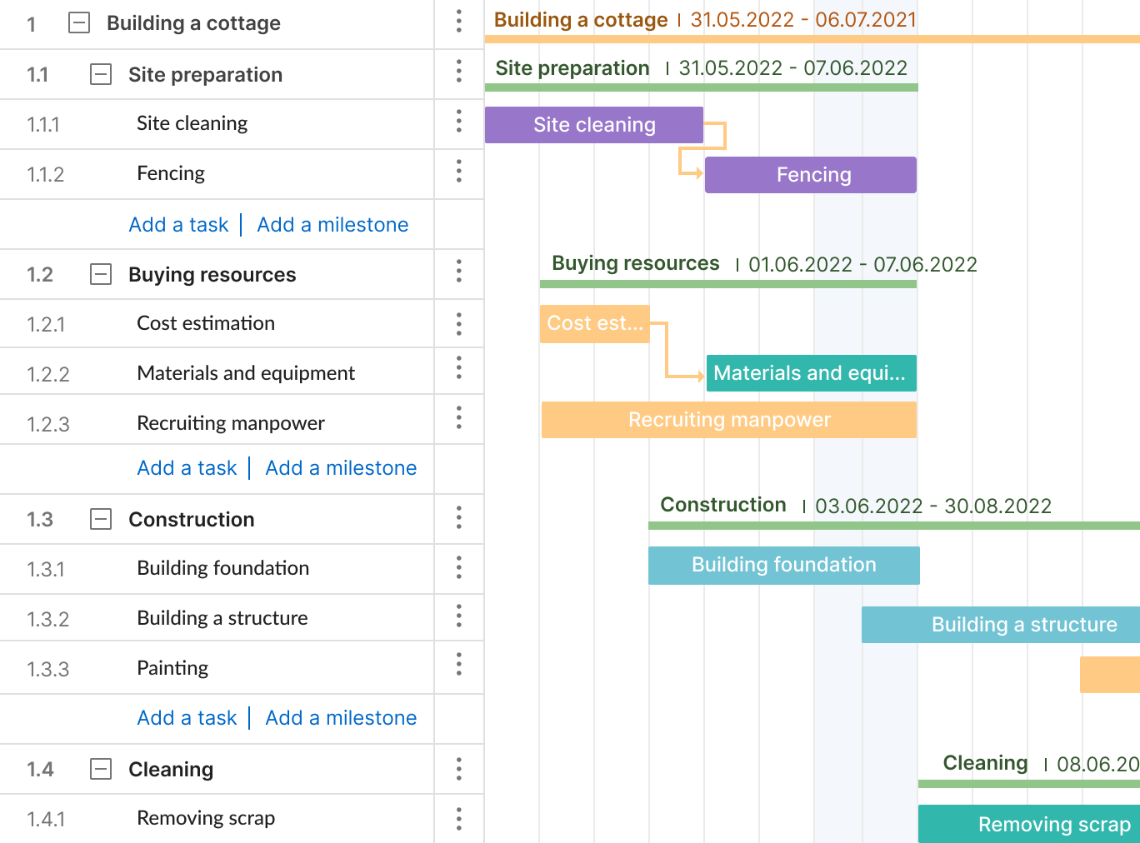

Slide 44
Approaches to Developing WBS
Using guidelines
The analogy approach
The top-down approach
The bottom-up approach
The mind-mapping approach
Notes:
How to plan, track, and report requirements activities
How to perform configuration management activities
How to prioritize requirements
How to use product metrics
How to trace and capture attributes of requirements

Slide 45
Using Guidelines
If guidelines exist for developing a WBS, it is very important to follow them.
the U.S. Department of Defense (DOD), for example - prescribe the form and content for WBSs for particular projects

Slide 46
Using Guidelines
The cost for the entire project must be calculated by summing the costs of all of the lower-level WBS tasks.

Slide 47
Using Guidelines
When DOD personnel evaluate cost proposals, they must compare the contractors’ costs with the DOD’s estimates.
A large variation in costs for a certain WBS task often indicates confusion as to what work must be done.

Slide 48
Using Guidelines
Many organizations provide guidelines and templates for developing WBSs, as well as examples of WBSs from past projects.
Microsoft Project 2013 comes with several templates, and more are available on Microsoft’s website and other sites.

Slide 49
The Analogy Approach
In the analogy approach, you use a similar project’s WBS as a starting point.
Some organizations keep a repository of WBSs and other project documentation on file to assist people working on projects.

Slide 50
The Analogy Approach
In the analogy approach, you use a similar project’s WBS as a starting point.
Some organizations keep a repository of WBSs and other project documentation on file to assist people working on projects.

Slide 51
The Top-Down Approach
To use the top-down approach, start with the largest items of the project and break them into subordinate items.
This process involves refining the work into greater and greater levels of detail.

Slide 52
The Bottom-Up Approach
In the bottom-up approach, team members first identify as many specific tasks related to the project as possible.
Then aggregate the specific tasks and organize
them into summary activities, or higher levels in the WBS.

Slide 53
The Bottom-Up Approach
For example, a group of people might be responsible for creating a WBS to develop an e-commerce application.

Slide 54
The Bottom-Up Approach
Instead of looking for guidelines on how to create a WBS or viewing WBSs from similar projects, they could begin by listing detailed tasks they think they would need to perform in order to create the application.

Slide 55
The Bottom-Up Approach
After listing these detailed tasks, they would group the tasks into categories.
Then they would group these categories into higher-level categories.

Slide 56
Mind Mapping
Mind mapping
is a technique that uses branches radiating from a core idea to structure thoughts and ideas.

Slide 57
Mind Mapping
Instead of writing
down tasks in a list or immediately trying to create a structure for tasks, mind mapping allows people to write and even draw pictures of ideas in a nonlinear format.

Slide 58
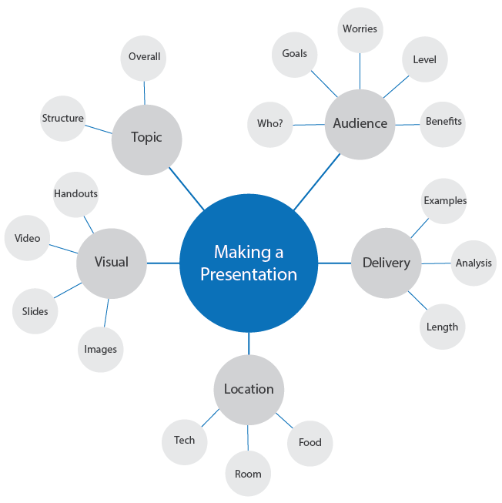
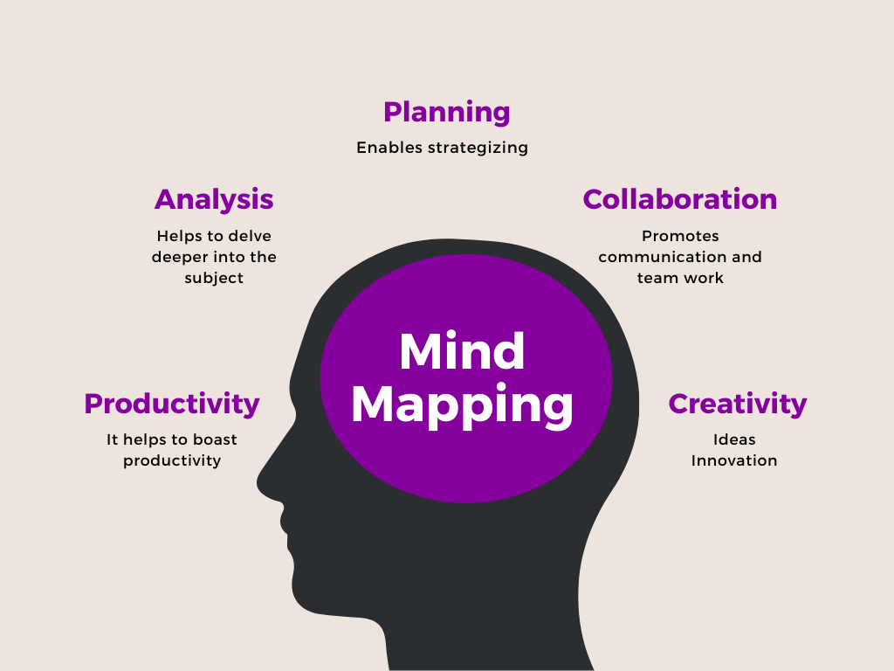
Mind Mapping

Slide 59
Mind Mapping
After discovering WBS items and their structure using the mind-mapping technique, you could then translate the information into chart or tabular form, as described earlier.

Slide 60
Mind Mapping
Mind mapping can be used for developing WBSs using the top-down or bottom-up approach.

Slide 61
Mind Mapping
For example, you could conduct mind mapping for an entire project by listing the project in the center of a document,
adding the main categories on branches radiating from the center, and then adding branches for appropriate subcategories.

Slide 62
Mind Mapping
You could also develop a separate mind-mapping diagram for each deliverable and then merge them to create one large diagram for the entire project.

Slide 63
Mind Mapping
You can also add items anywhere on
a mind-mapping document without following a strict top-down or bottom-up approach.

Slide 64
Mind Mapping
After the mind-mapping documents are complete, you can convert them into a chart or tabular WBS form.

